Slide 1

Fighting Back Against Domestic Abuse:
Helping Domestic Violence Survivors Through Representation, Advocacy, and Policy - Examined Through a Tax Lens
Panel 2: Trauma-Informed Advocacy
The Community Tax Law Project
30th Anniversary Event
November 15, 2022

Slide 2
Our Panelists
Tanya Gould, Anti-Human Trafficking, VA Commonwealth Attorney General’s Office
John Richardson-Lauve, ChildSavers
Moderated by Caitlin Bradley, Virginia Sexual and Domestic Violence Action Alliance

Slide 3


What is Trauma?
Traumatic Event: An event or series of events that cause moderate to severe stress reactions.
Trauma: Individual trauma results from an event or series of events, or set of circumstances that is experienced by an individual as physically or emotionally harmful or life-threatening and that has lasting adverse effects on the individuals functioning and mental, physical, social, emotional, or spiritual well-being.

Slide 4
What does it mean to be
Trauma-Informed?
Trauma-Informed Approach: A trauma-informed approach is inclusive of trauma-specific interventions, whether assessment, treatment, or recovery supports, yet it also incorporates key principles into organizational culture.

Slide 5
Traumas Impact: The Psychology of Post-Traumatic Stress Disorder TedTalk
Notes:
Video is hyperlinked.
Supplemental Notes related/comments to HPA axis and PTSD from: Traumatic Stress: Effects on the Brain by J. Douglas Bremner, MD. Dialogues in Clinical Neuroscience. 2006 Dec; 8(4): 445-61. Dei:10.31887/DCNS.2006.8.4/jbremner

Slide 6
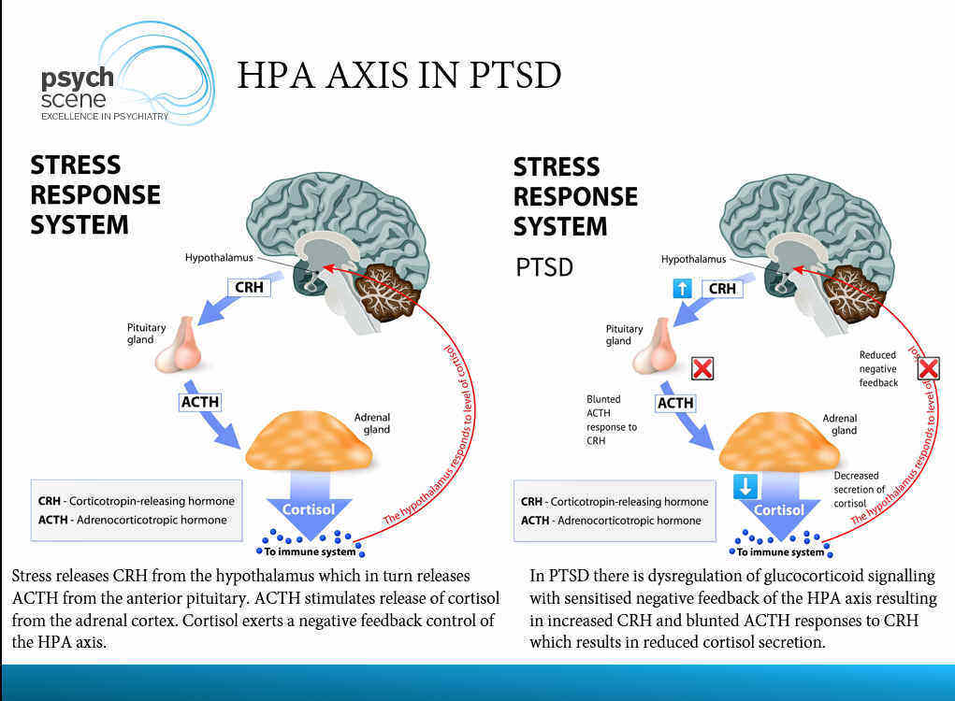

HPA Axis in PTSD
Notes:
Comments will be informed by 1) HPA axis and PTSD from: Traumatic Stress: Effects on the Brain by J. Douglas Bremner, MD. Dialogues in Clinical Neuroscience. 2006 Dec; 8(4): 445-61. Dei:10.31887/DCNS.2006.8.4/jbremner
And
2) How Stress and Trauma Impact the Brain: Trauma and the Brain – Neurobiology – PTSD 2022 Dr. Sanil Rege and article https://psychscenehub.com/psychinsights/post-traumatic-stress-disorder/
And
3) The Neurobiological Impact of Psychological Trauma: The HPA Axis. Dr. Dawn-Elise Snipes of ALL CEUs Counseling Education – Tools for Mental Health and Addiction Recovery Counselor Toolbox Feb 29,2020.
Supplemental material from Dr Nadine Burke Harris ACES and HPA axis https://www.ted.com/talks/nadine_burke_harris_how_childhood_trauma_affects_health_across_a_lifetime?language=en#t-1005516

Slide 7
Trauma Responses/ Stress Response
Fight
Flight
During the Event
Freeze
Fawn

Slide 8
Have you had any clients describe these?

Slide 9
Immediate Emotional Reactions
Feeling unreal; depersonalization
(e.g., feeling as if you are watching yourself)
Sadness
Numbness & Detachment
Guilt
(including survivor guilt)
Helplessness & Feeling overwhelmed
Disorientation
Anxiety or severe fear
Exhilaration as a result of survival
Anger
Feeling out of Control
Denial
Constriction of feelings

Slide 10
Delayed Emotional Reactions
Irritability and/or hostility
Depression
Mood swings, instability
Anxiety (e.g., phobia, generalized anxiety)
Fear of trauma recurrence
Grief reactions
Shame
Feelings of fragility and/or vulnerability
Emotional detachment from anything that requires emotional reactions)

Slide 11
Immediate Physical Reactions
Nausea and/or gastrointestinal distress
Sweating or shivering
Faintness
Muscle tremors or uncontrollable shaking
Elevated heartbeat, respiration, and blood pressure
Extreme Fatigue or exhaustion
Greater startle responses
Depersonalization

Slide 12
Delayed Physical Reactions
Sleep disturbances, nightmares
Somatization (e.g., increased focus on and worry about body aches and pains)
Appetite and digestive changes
Lowered resistance to colds and infection
Persistent fatigue
Elevated cortisol levels
Hyperarousal
Long-term health effects including heart, liver, autoimmune, and chronic obstructive pulmonary disease

Slide 13
Immediate Cognitive Reactions
Difficulty concentrating
Rumination or racing thoughts (e.g. replaying the traumatic event over and over again)
Distortion of time and space (e.g., traumatic event may be perceived as if it was happening in slow motion, or a few seconds can be perceived as minutes)
Memory problems (e.g., not being able to recall important aspects of the trauma)
Strong identification with victims
Notes:
This slide has SO much text on it idk what to do about that; Sources: Briere & Scott, 2006b; Foa et al., 2006; Pietrzak et al., 2011 (as cited in TIP 57 from the Substance Abuse and Mental Health Services Administration [SAMHSA])

Slide 14
Delayed Cognitive Reactions
Intrusive memories or flashbacks
Reactivation of previous traumatic events
Self-blame
Preoccupation with event
Difficulty making decisions
Magical thinking: belief that certain behaviors, including avoidant behavior, will protect against future trauma
Belief that feelings or memories are dangerous
Generalization of triggers (e.g., a person who experiences a home invasion during the daytime may avoid being alone during the day)
Suicidal thinking

Slide 15
Immediate Behavioral Reactions
Withdrawal and apathy
Startled Reactions
Increased use of drugs, tobacco and alcohol
Restlessness
Argumentative Behavior
Sleep and appetite disturbances
Difficulty expressing oneself
Avoidant

Slide 16
Delayed Behavioral Reactions
Avoidance of event reminders
Social relationship disturbances
Decreased activity level
Engagement in high-risk behaviors
Increased use of alcohol and drugs
Withdrawal

Slide 17
Immediate Existential Reactions
Prayer
  Intense use of prayer
Restoration
  Restoration of faith in the goodness of others (e.g., receiving help from others)
Loss
  Loss of self-efficacy
Despair
  Despair about humanity, particularly if the event was intentional
Disruption
  Immediate disruption of life assumptions (e.g., fairness, safety, goodness, predictability of life)
Notes:
This slide has SO much text on it idk what to do about that; Sources: Briere & Scott, 2006b; Foa et al., 2006; Pietrzak et al., 2011 (as cited in TIP 57 from the Substance Abuse and Mental Health Services Administration [SAMHSA])

Slide 18
Delayed Existential Reactions
Questioning (e.g., “Why me?”)
Increased cynicism, disillusionment
Increased self-confidence (e.g., “If I can survive this, I can survive anything”)
Loss of purpose
Renewed faith
Hopelessness
Reestablishing priorities
Redefining meaning and importance of life
Reworking life’s assumptions to accommodate the trauma (e.g., taking a self-defense class to reestablish a sense of safety)

Slide 19
What behaviors or signs have you seen from clients that may have been indicators of trauma?
What behaviors or signs have you seen from clients that may have indicated they had been triggered in court? In your office?
During a phone call?

Slide 20
Trauma-Informed Response: The 3 E’s
Events
Effects
Experiences

Slide 21
Trauma Informed Response
Realize
Recognize
The 4 R’s
Resist Re-Traumatization
Respond

Slide 22

How to avoid re-traumatization

Slide 23
Key Principles of a Trauma-Informed Approach
Safety
Trustworthiness & Transparency
Peer Support
Collaboration & Mutuality
Empowerment, Voice, Choice
Historical, Cultural and Gender Issues

Slide 24
Resources
Traumatic Stress: Effects on the Brain by J. Douglas Bremner, MD. Dialogues in Clinical Neuroscience. 2006 Dec; 8(4): 445-61. Dei:10.31887/DCNS.2006.8.4/jbremner
Briere & Scott, 2006b; Foa et al., 2006; Pietrzak et al., 2011 (as cited in TIP 57 from the Substance Abuse and Mental Health Services Administration [SAMHSA])
Supplemental material from Dr Nadine Burke Harris ACES and HPA axis https://www.ted.com/talks/nadine_burke_harris_how_childhood_trauma_affects_he alth_across_a_lifetime?language=en#t-1005516
Joelle Rabow Maletis: The psychology of post-traumatic stress disorder | TED Talk
How Stress and Trauma Impact the Brain: Trauma and the Brain – Neurobiology – PTSD 2020 Dr. Sanil Rege and article https://psychscenehub.com/psychinsights/posttraumatic-stress-disorder/
The Neurobiological Impact of Psychological Trauma: The HPA Axis. Dr. Dawn-Elise Snipes of ALL CEUs Counseling Education – Tools for Mental Health and Addiction Recovery Counselor Toolbox Feb 29,2020

Slide 25
How would learning to recognize and effectively respond to trauma impact your ability to practice law?

Slide 26
Reminder: Trauma is Re-Experienced in Real Time
Trauma is not something that happened in the past
  Trauma is a present experience in the body in reaction to a trigger
  This is why victim’s feel stuck or “locked” in the past
  Traumatized people are experiencing physical symptoms when they relive the past

Slide 27
Common Triggers to Trauma Responses
Sounds
Smells
Colors
Movements
Objects
Anniversaries
Significant life events
Events or situations that resemble or symbolize the trauma

Slide 28
Trauma responses are NORMAL reactions to ABNORMAL situations
-however-
They may appear to be ABNORMAL or INNAPROPRIATE to the untrained eye

Slide 29
Preventing Re-Traumatization
Do no harm
Non-Violent approach to client interactions
Center client autonomy

Slide 30
Centering Client Autonomy
Focus on restoring a victim’s sense of control and autonomy over her body, surroundings, and destiny
“[T]he attorney acts both professionally and morally in assisting clients to maximize their autonomy .... [T]he attorney acts unprofessionally and immorally by depriving clients of their autonomy, that is, by denying them information regarding their legal rights, by otherwise preempting their moral decisions, or by depriving them of the ability to carry out their lawful decisions.”
Notes:
Monroe H. Freedman, Client-Centered Lawyering-What it Isn’t, 40 Hofstra L. Rev.
2, (2011), available at
https://scholarlycommons.law.hofstra.edu/cgi/viewcontent.cgi?article=2661&amp;context=
hlr

Slide 31
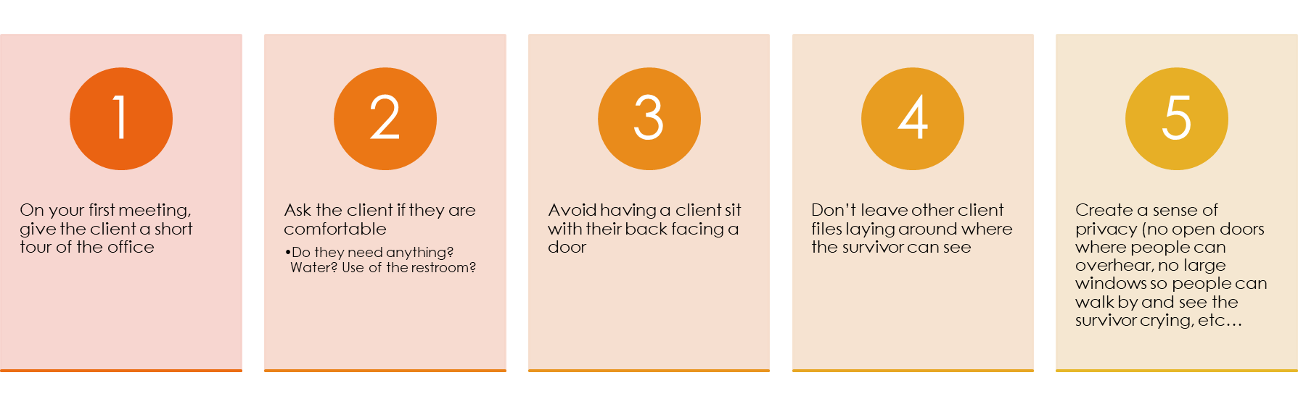
Establish Physical Security

Slide 32
Establish the Relationship
Prioritize client autonomy/boundaries
Center client’s identity
Explain your role
Flatten the power dynamic
Monitor client for signs of distress/trauma responses

Slide 33
In what ways might an attorney-client relationship inadvertently mimic an abusive relationship?

Slide 34
Trauma Informed Communication
Be present
Non-reactive (i.e. aware of your OWN triggers)
Focus on persuasion rather than coercion

Slide 35
Trauma Informed Communication
Instead of “I get it” try: “I hear you”
Instead of “Why did you do that?” try “Tell me more about your response to that situation.”
Instead of “Calm down” try “Help me understand what you need from me right now”
Instead of “That’s not relevant” try first validating their sense of unfairness before explaining the limitations of the law to address certain types of injustices.

Slide 36
Where does a local advocate fit in?
Find your local sexual and domestic violence program
Make use of advocates—they can make your work easier by providing victims with emotional support, safety planning and resources

Slide 37
What is vicarious or secondary trauma?
The condition resembles post traumatic stress disorder and is caused by being indirectly exposed to someone who is experiencing trauma
It can develop from listening to others recount a traumatic event or working with others who are dealing with trauma
Notes:
Trauma-Informed Lawyering (acl.gov)

Slide 38
How does secondary trauma manifest in the workplace?
Avoidance
Hypervigilance (feeling on edge, perceiving clients and colleagues as threatening, feeling like all clients are in danger)
Black and white thinking, as opposed to tolerating ambiguity
Undue frustration with clients
Losing empathy towards clients
Becoming overly argumentative
Notes:
Sources- Trauma-Informed Lawyering (acl.gov), Understanding Secondary Trauma: A Guide for Lawyers Working with Child Victims (americanbar.org)

Slide 39
How does secondary trauma manifest in one’s personal life?
Sleep disturbances and nightmares
Headaches
Stomach pains
PTSD symptoms
Extreme fatigue
Negative thinking
Strained relationships with family and friends
Difficulty parenting
Notes:
PTSD symptoms include: (such as intrusive thoughts and memories, severe emotional distress or physical reactions to something that reminds the person of the traumatic event, avoidance of people or places that remind the person of the event, irritability, angry outbursts, aggressive behavior, inability to focus, hypervigilance)
Understanding Secondary Trauma: A Guide for Lawyers Working with Child Victims (americanbar.org)

Slide 40
How to help yourself:
  Practice good work/life balance
  Recognize the signs of vicarious trauma
    Irritability, troubled sleep, excessive drinking, paranoia
    Personal history with murder of client contributing to vicarious trauma you are experiencing with current client
  Reach out to local and statewide resources
    Virginia Action Alliance
    VJLAP
  Seek assistance through therapy
  Talk about secondary trauma with colleagues (always being mindful, however, of your colleagues’ sensitivities)

Slide 41
Virginia Resources
Virginia Action Alliance is Virginia’s leading voice on issues related to sexual and domestic violence.
  The Action Alliance’s Project for the Empowerment of Survivors offers survivors of violence an opportunity to find answers to legal questions and information about local recourses which may aid their healing process. If you are suffering from secondary trauma, or suspect that a coworker or friend is experiencing symptoms of secondary trauma, please reach out to the PES for support and resource information.
    Call- 800-838-8238
Virginia Judges and Lawyers Assistance Program
  Provides confidential assistance for legal professionals dealing with mental health and/or substance abuse issues
  Call-877-545-4682
Notes:
Virginia Sexual & Domestic Violence Action Alliance (vsdvalliance.org)

Slide 42
Closing Reflection
Think about a time you felt very vulnerable and had to trust a professional (e.g. a doctor, another lawyer, a law enforcement officer). What are some specific things they did that either put you at ease or elevated your stress?

